Slide 1
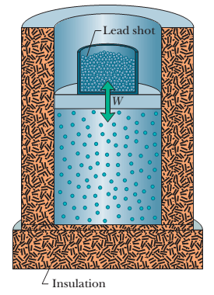
Lecture 4 Chapter 18: Temperature, heat and the first law of thermodynamics
15.5 Some Special Cases of the First Law of Thermodynamics
Adiabatic processes : An adiabatic process is one that occurs so rapidly or occurs in a system that is so well insulated that no transfer of energy as heat occurs between the system and its environment .
Q = 0

Slide 2
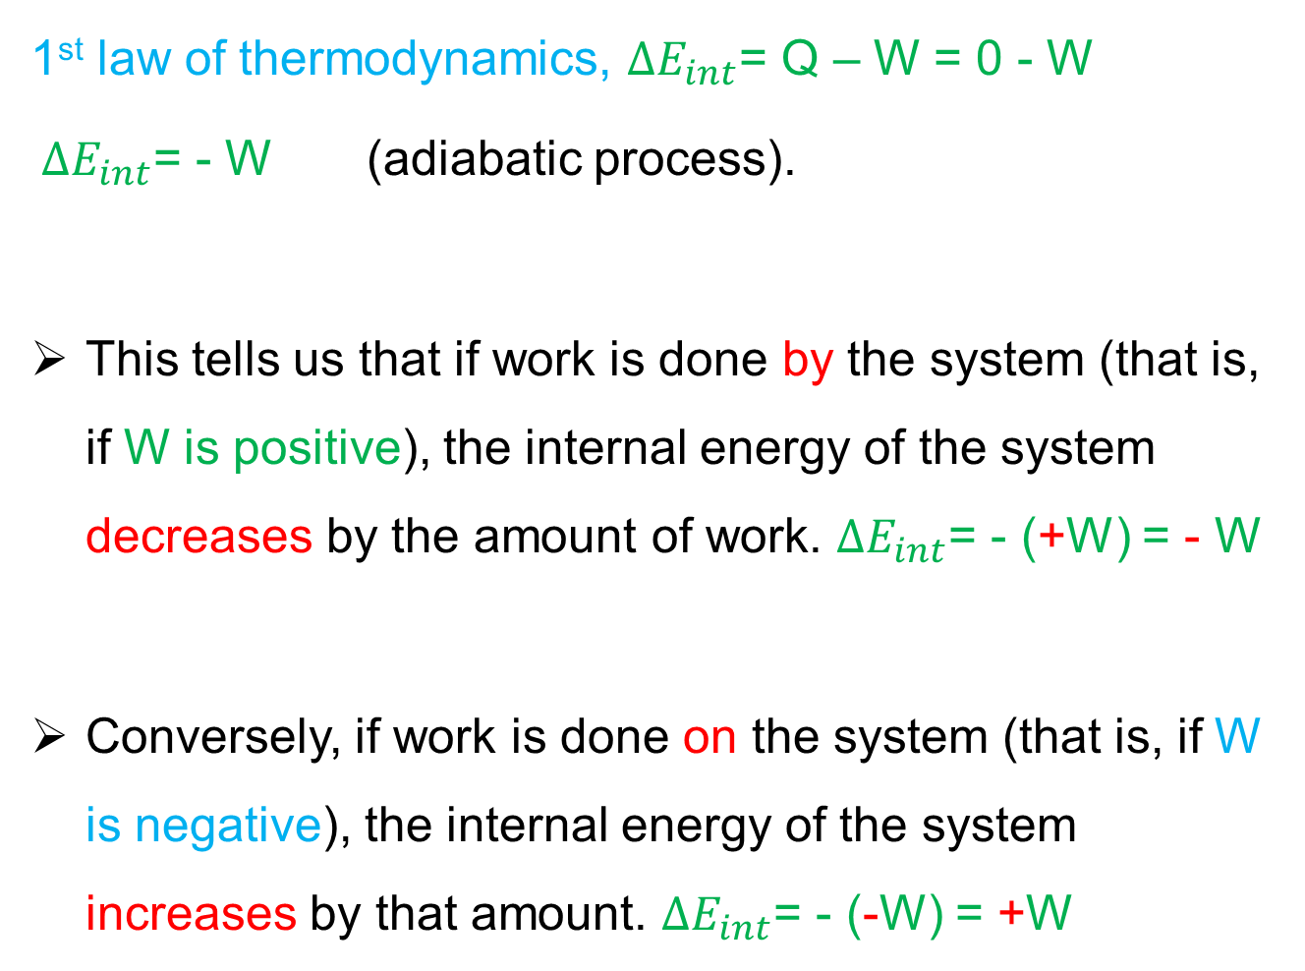
1st law of thermodynamics, $∆E_{int}$= Q – W = 0 - W
$∆E_{int}$= - W (adiabatic process).
This tells us that if work is done by the system (that is, if W is positive), the internal energy of the system decreases by the amount of work. $∆E_{int}$= - (+W) = - W
Conversely, if work is done on the system (that is, if W is negative), the internal energy of the system increases by that amount. $∆E_{int}$= - (-W) = +W

Slide 3
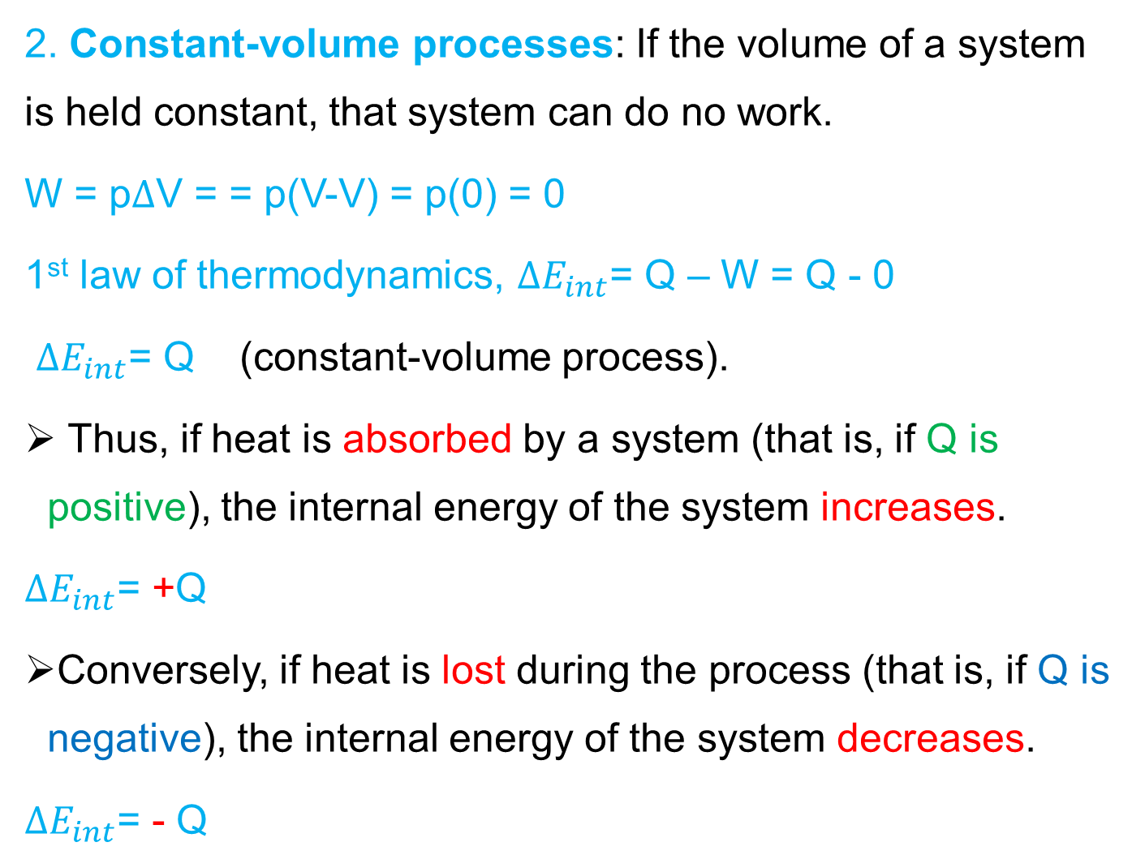
2. Constant-volume processes: If the volume of a system is held constant, that system can do no work.
W = p$∆$V = = p(V-V) = p(0) = 0
1st law of thermodynamics, $∆E_{int}$= Q – W = Q - 0
$∆E_{int}$= Q (constant-volume process).
Thus, if heat is absorbed by a system (that is, if Q is positive), the internal energy of the system increases.
$∆E_{int}$= +Q
Conversely, if heat is lost during the process (that is, if Q is negative), the internal energy of the system decreases.
$∆E_{int}$= - Q

Slide 4
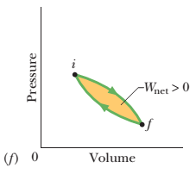
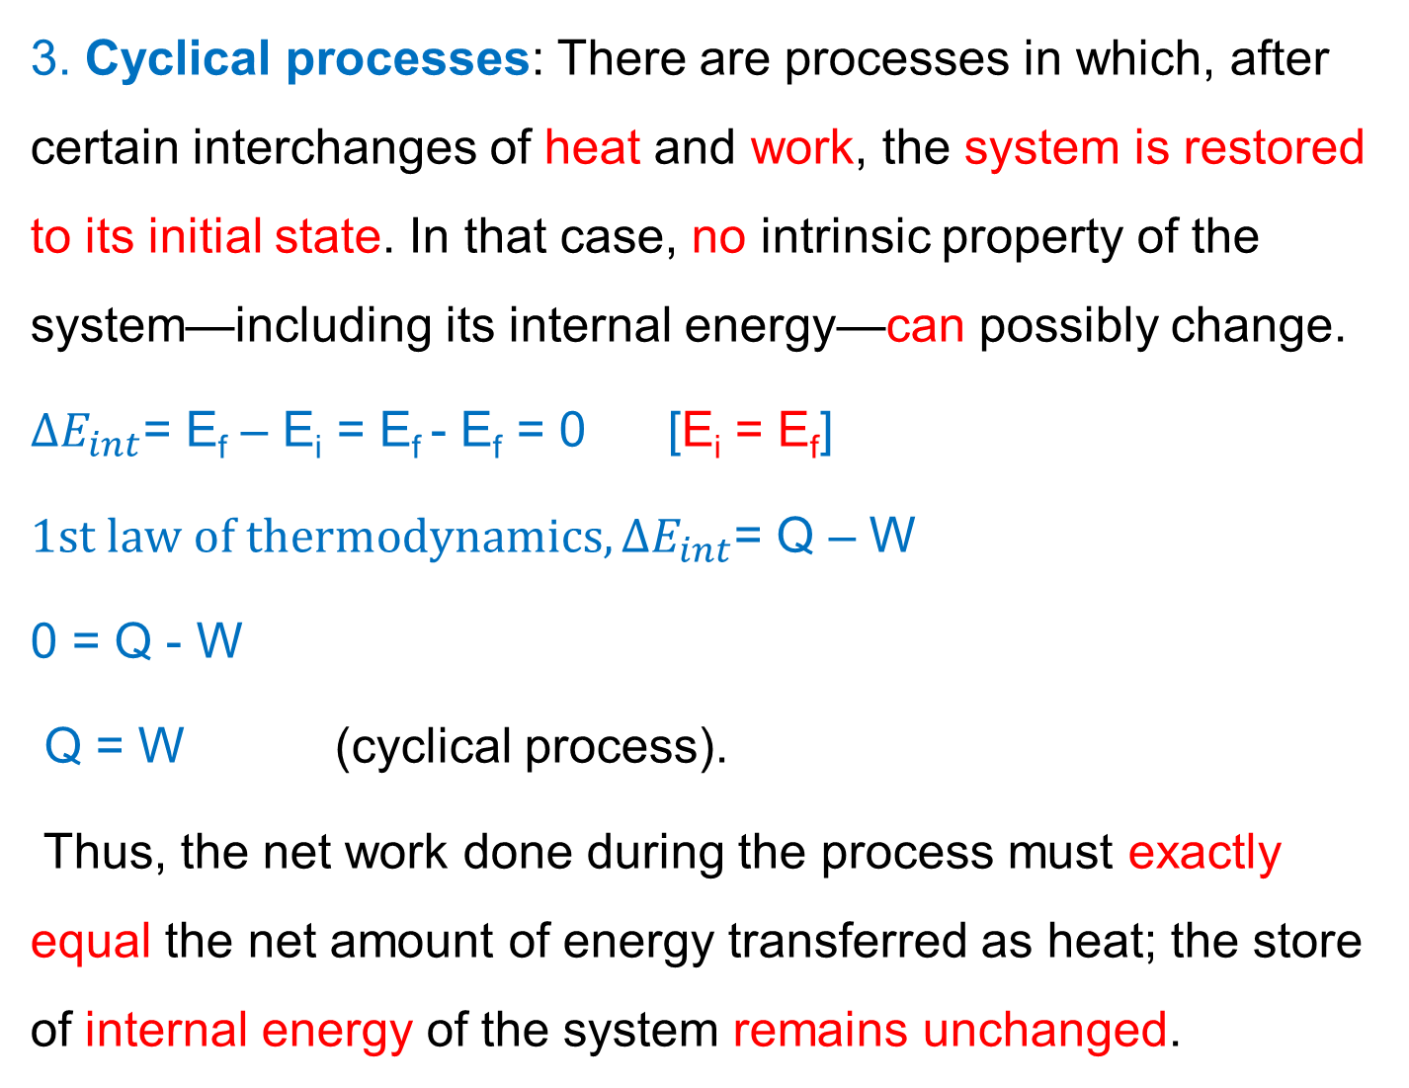
3. Cyclical processes: There are processes in which, after certain interchanges of heat and work, the system is restored to its initial state. In that case, no intrinsic property of the system—including its internal energy—can possibly change.
$∆E_{int}$= E_{f} – E_{i} = E_{f} - E_{f} = 0 [E_{i} = E_{f}]
$1st law of thermodynamics, ∆E_{int}$= Q – W
0 = Q - W
Q = W (cyclical process).
Thus, the net work done during the process must exactly equal the net amount of energy transferred as heat; the store of internal energy of the system remains unchanged.

Slide 5
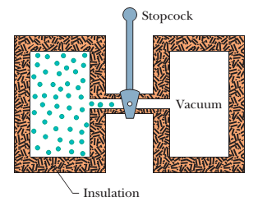
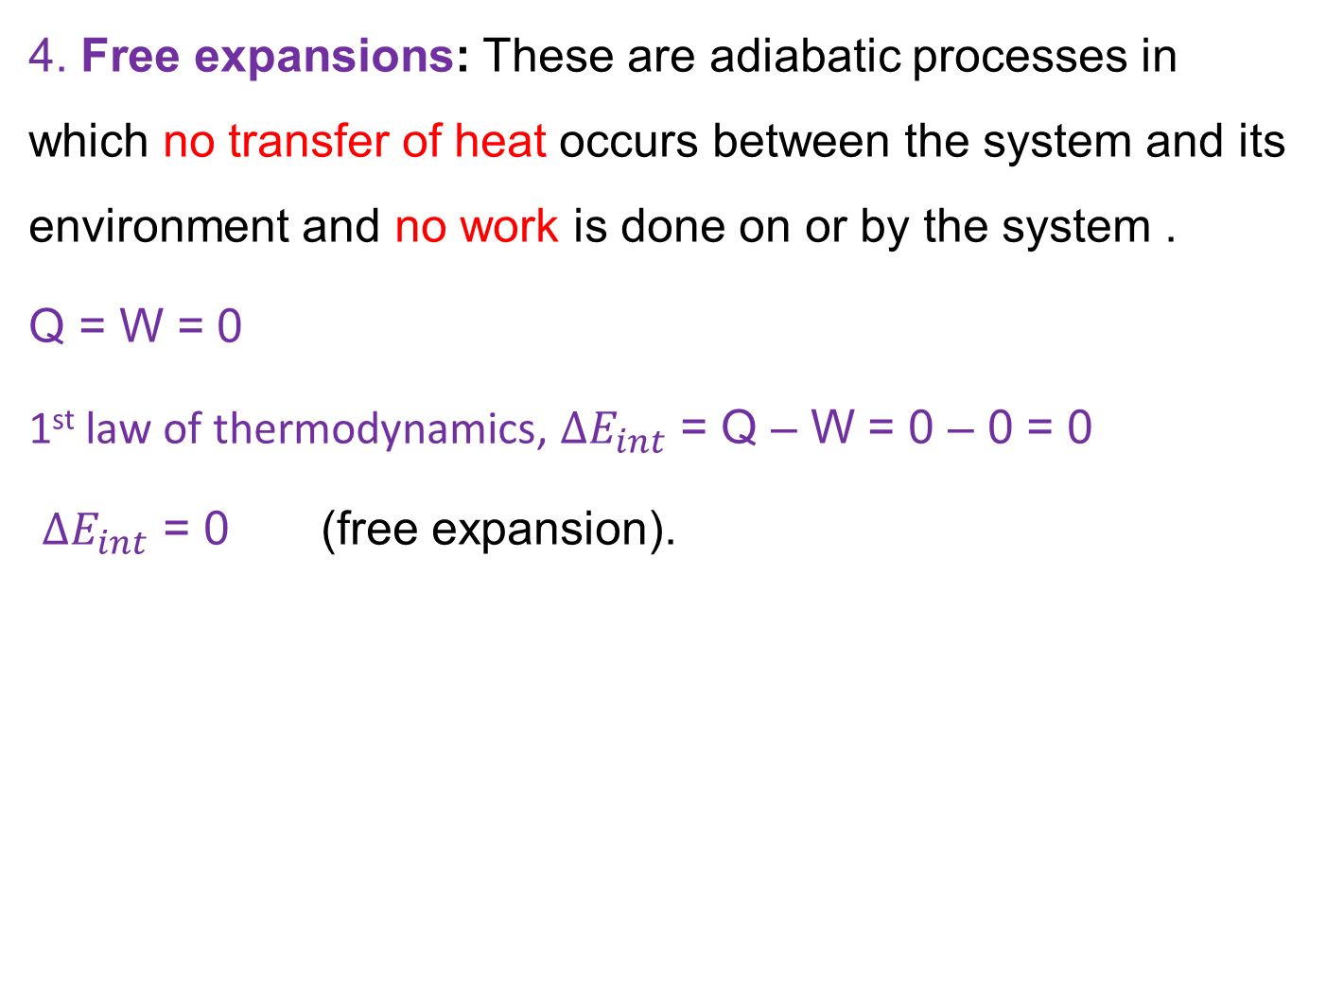
4. Free expansions: These are adiabatic processes in which no transfer of heat occurs between the system and its environment and no work is done on or by the system .
Q = W = 0
1st law of thermodynamics, $∆E_{int}$ = Q – W = 0 – 0 = 0
$∆E_{int}$ = 0 (free expansion).

Slide 6
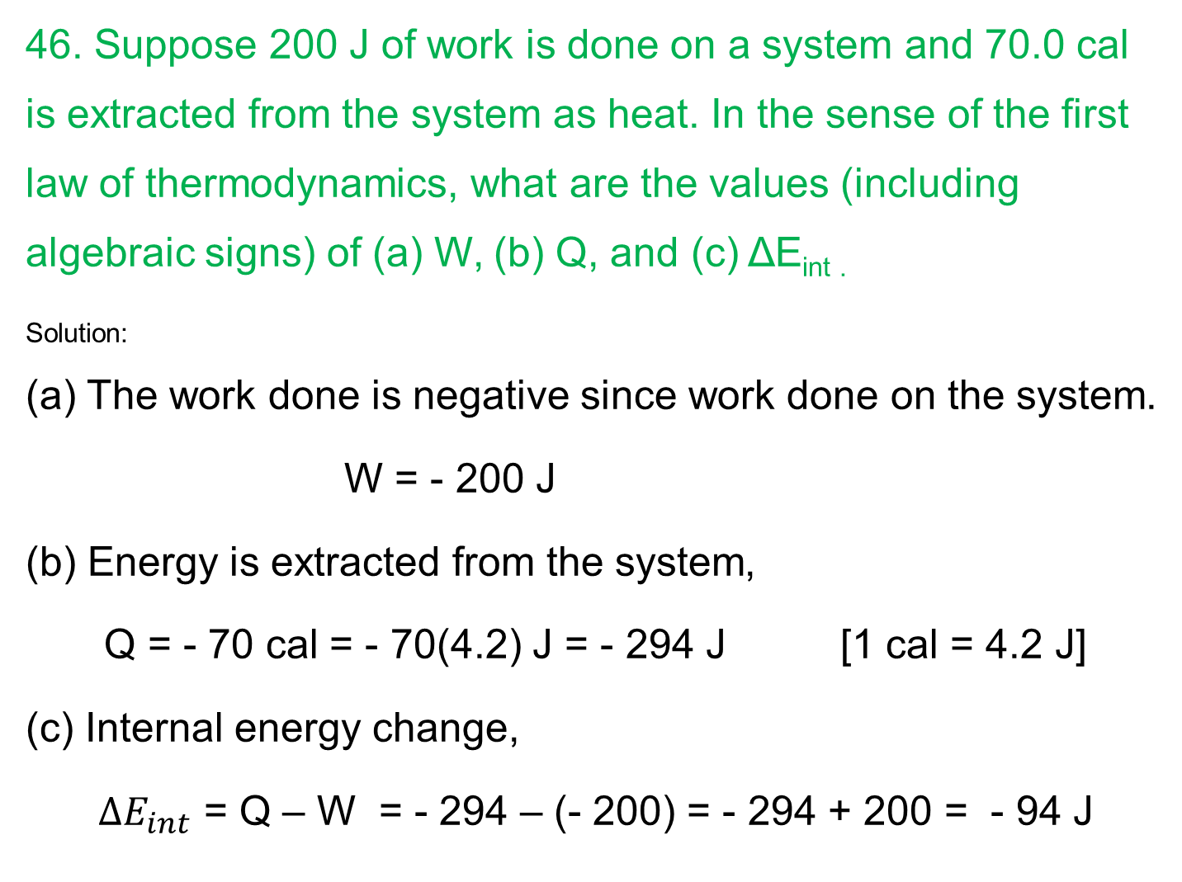
46. Suppose 200 J of work is done on a system and 70.0 cal is extracted from the system as heat. In the sense of the first law of thermodynamics, what are the values (including algebraic signs) of (a) W, (b) Q, and (c) ΔE_{int .}
_{Solution:}
(a) The work done is negative since work done on the system.
W = - 200 J
(b) Energy is extracted from the system,
Q = - 70 cal = - 70(4.2) J = - 294 J [1 cal = 4.2 J]
(c) Internal energy change,
$∆E_{int}$ = Q – W = - 294 – (- 200) = - 294 + 200 = - 94 J

Slide 7
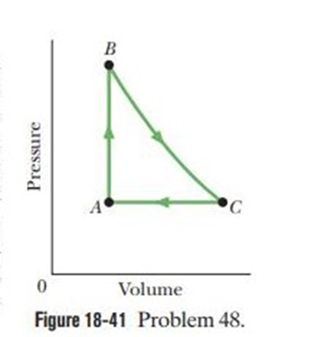

48. As a gas is held within a closed chamber, it passes through the cycle shown in Fig. Determine the energy transferred by the system as heat during constant-pressure process CA if the energy added as heat Q_{AB} during constant-volume process AB is 20.0 J, no energy is transferred as heat during adiabatic process BC, and the net work done during the cycle is 15.0 J.
Solution:
First law of thermodynamics,
$∆E_{int}$= Q – W
For a cyclical process,
$∆E_{int}$= E – E = 0
0 = Q – W
Q = W
Q_{AB} + Q_{BC} + Q_{CA} = W
+20 + 0 + Q_{CA} = +15
Q_{CA} = - 5 J

